Slide 1
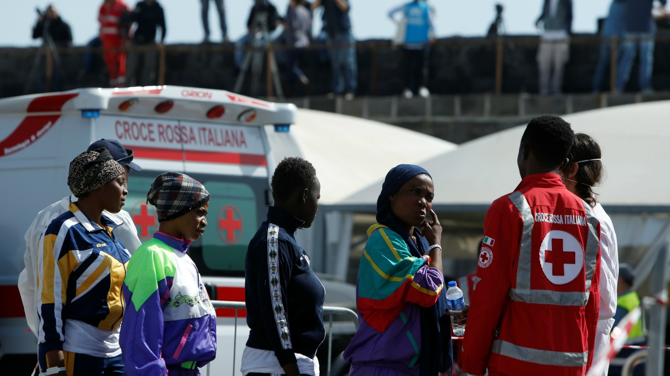



ANALYSIS OF FORCED DISPLACEMENTS IN AFRICA (2002-2017)
UNDERSTANDING THE MAIN FACTORS OF FORCED DISPLACEMENTS

Slide 2
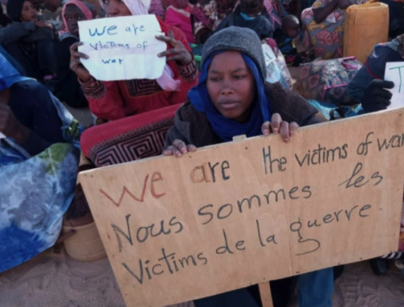
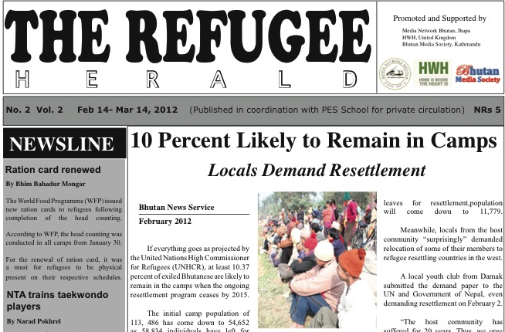
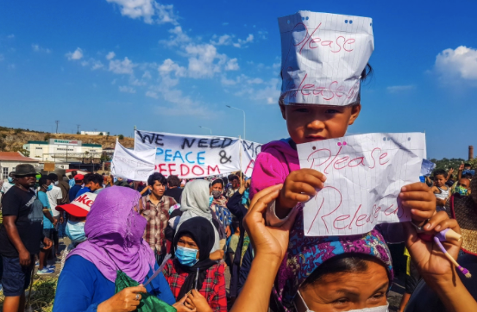
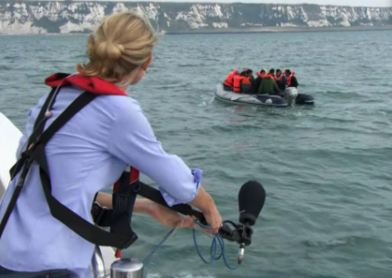

Slide 3
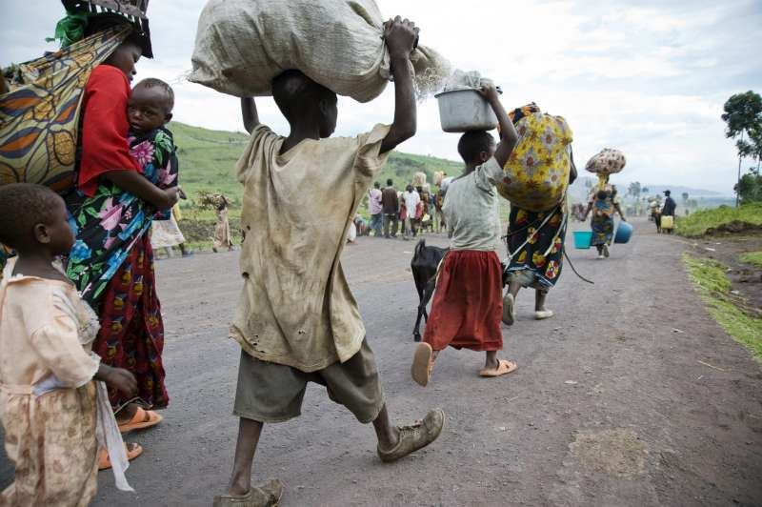
24 % of the Total Refugees are coming from Africa
What is happening in Africa?

Slide 4
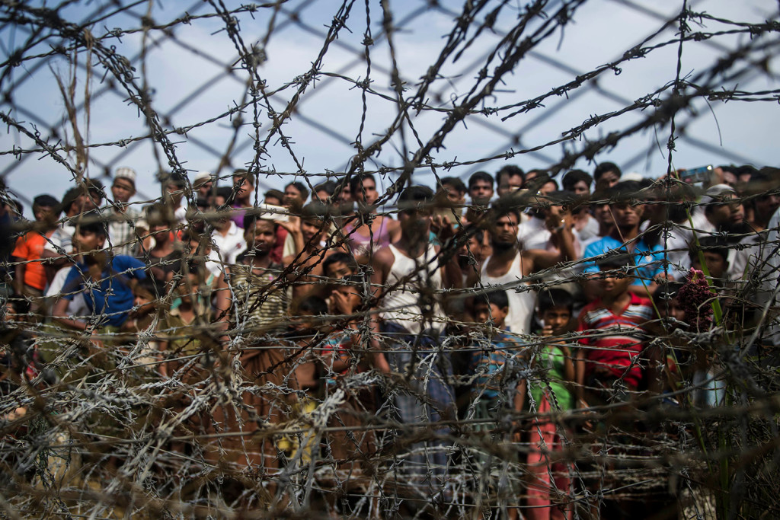


INTRODUCTION
Data | Sources
Water Coverage
Sanitation Coverage
Refugees
Asylum Applications
Form of Government, Control of Corruption, Rule of Law, Voice and Accountability, Regulatory Quality, Governance, Political Stability and Absence of Violence
Intestinal Deaths
AIDs Deaths

Slide 5
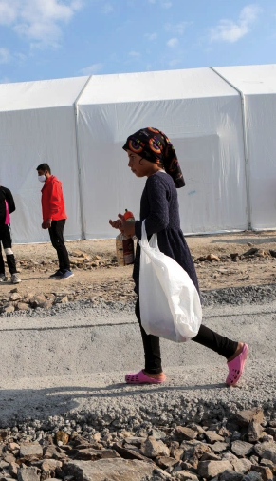
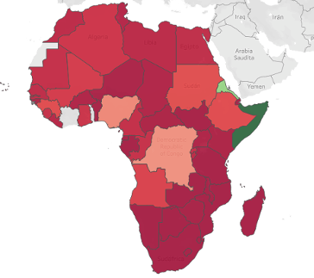
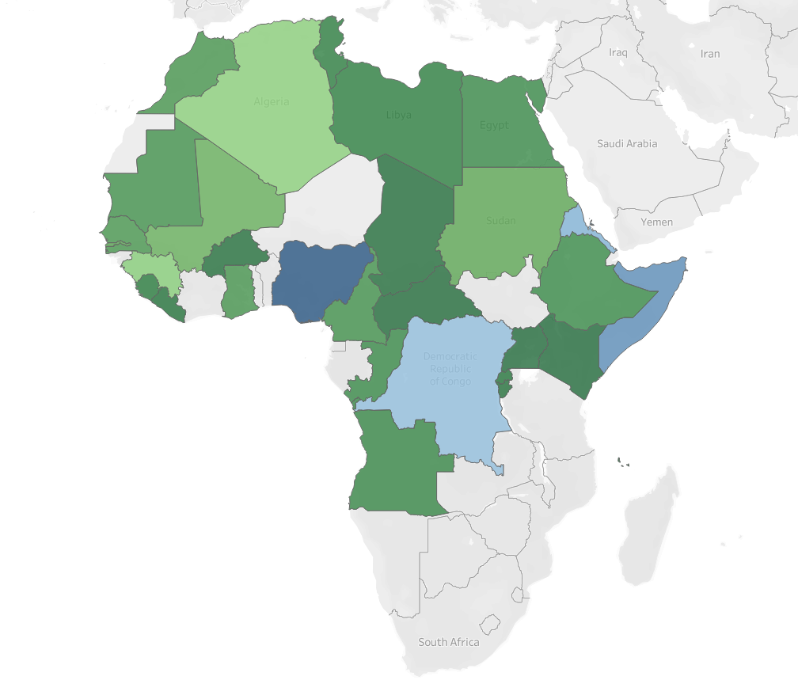
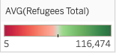
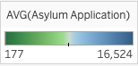
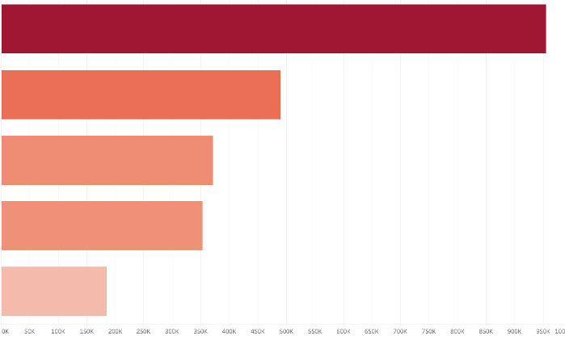
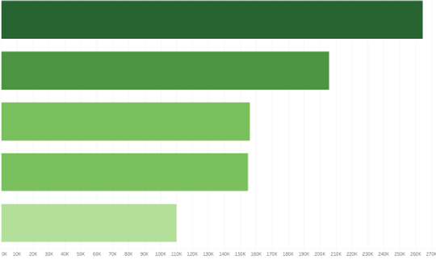
Average Number of Refugees per Country
Average Number of Asylum Applications per Country
Top 5 Countries (number of refugees)
Top 5 Countries (number of asylum seekers)
Somalia
Nigeria
Eritrea
Somalia
Dem.
Rep.Congo
Eritrea
Dem.
Rep.Congo
Nigeria
Sudan
Algeria

Slide 6
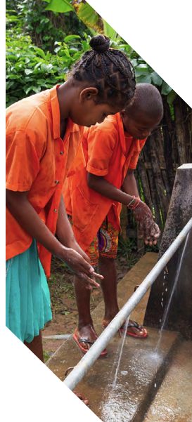
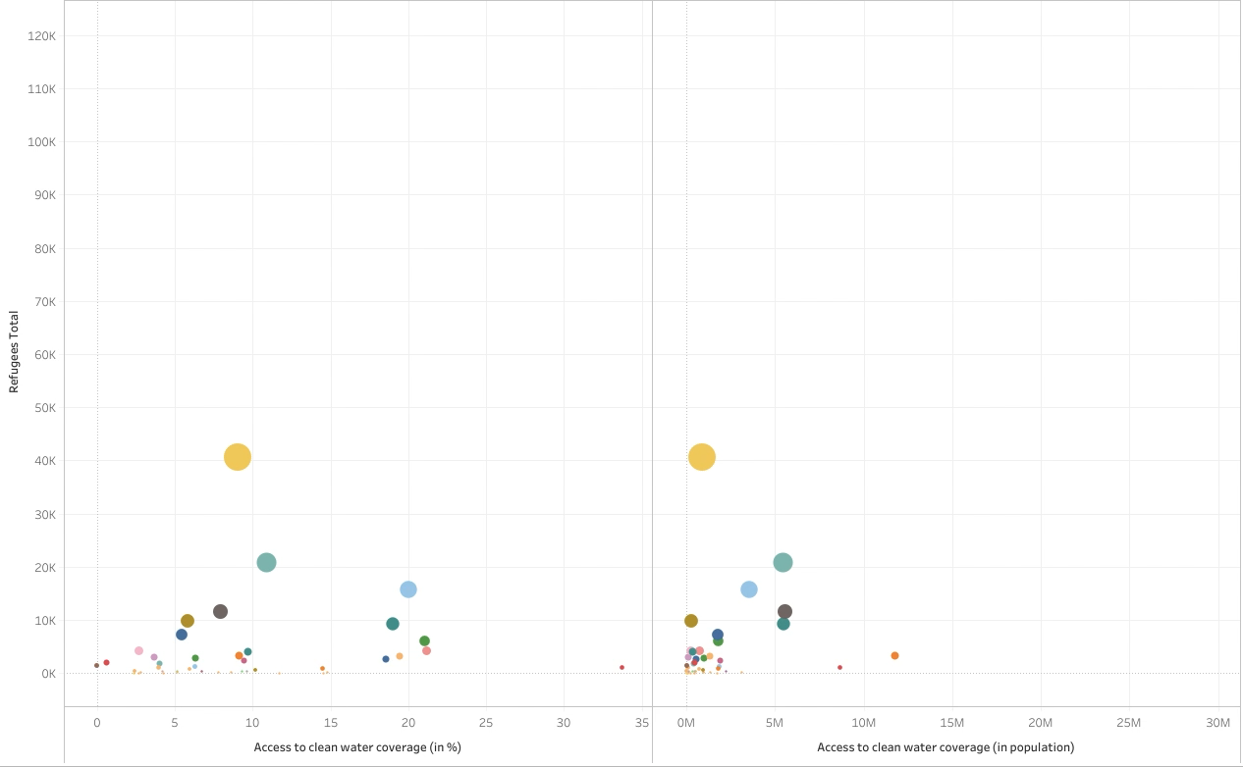
Limited Service
Drinking water from an improved source for which collection time exceeds 30 minutes for a roundtrip including queuing
Access to Clean Water Coverage

Slide 7
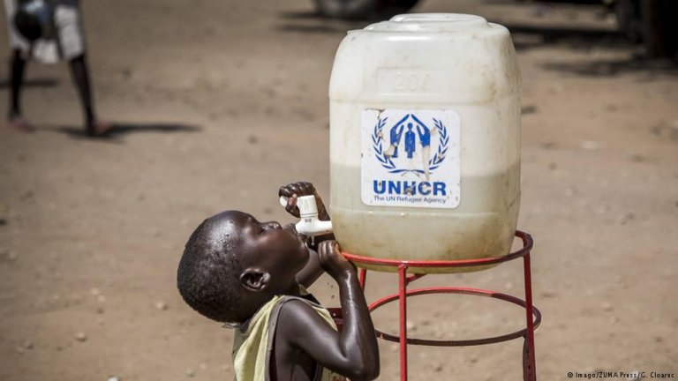
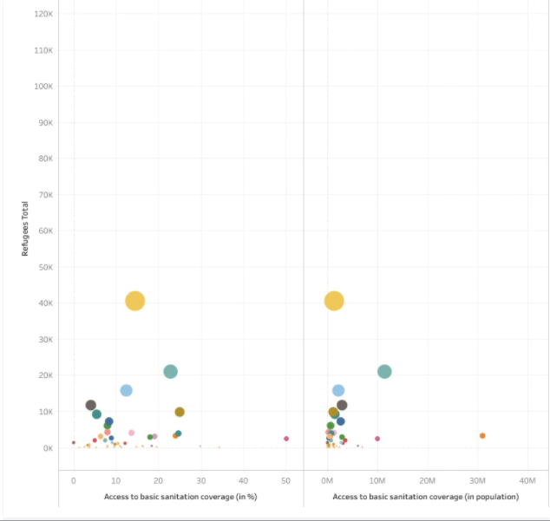
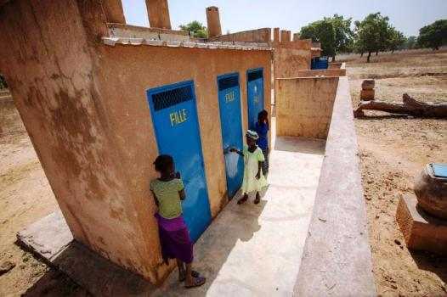
Limited Service
Use of improved facilities shared between two or more households
Access to Basic Sanitation Coverage

Slide 8
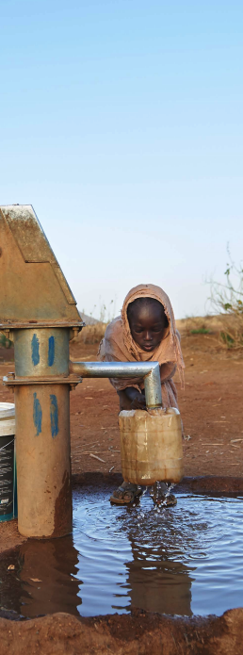
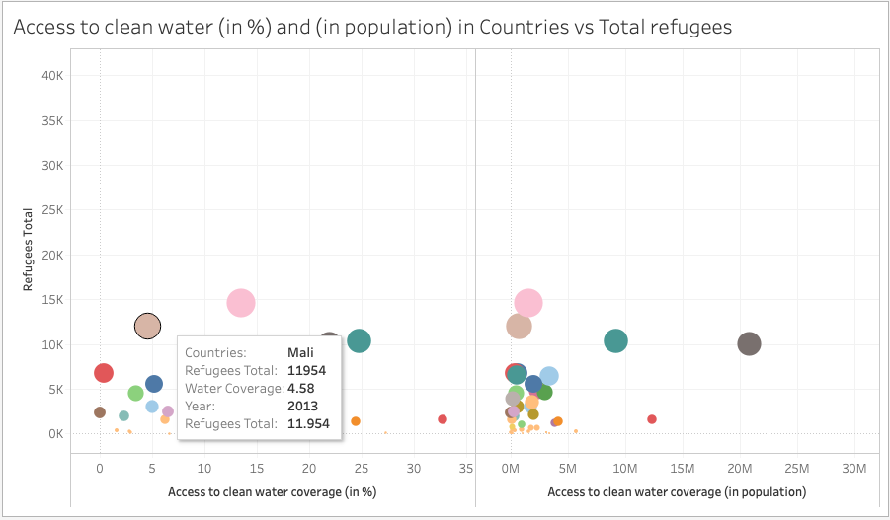
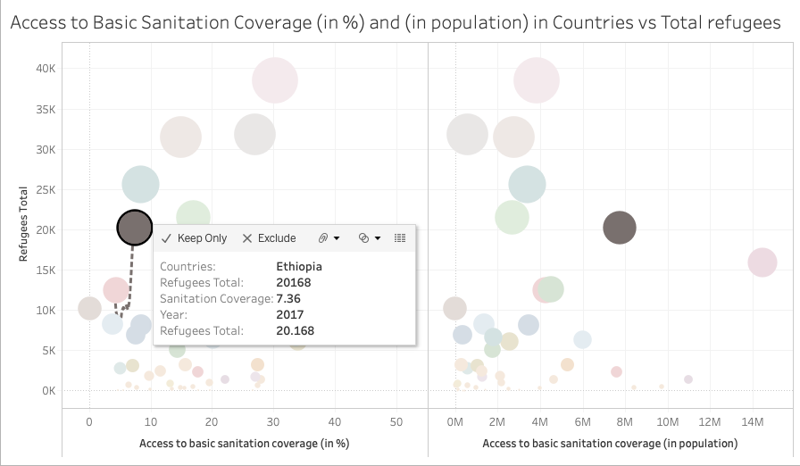
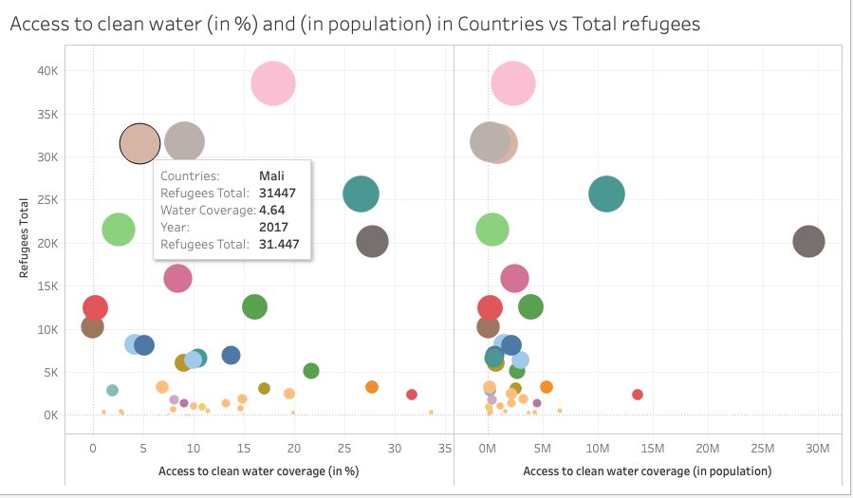
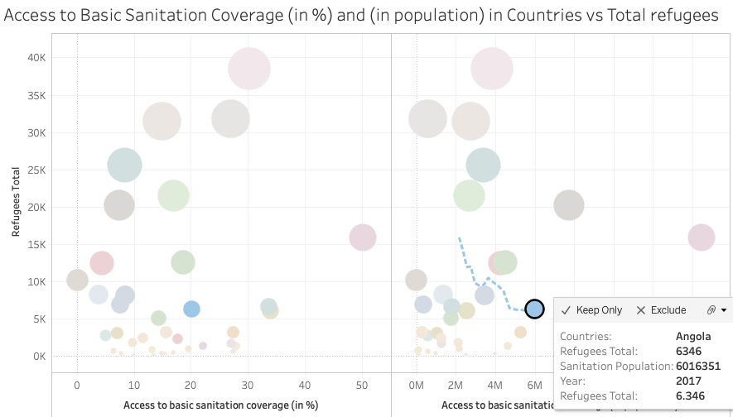
Comparison of Sanitation and Water Coverage

Slide 9
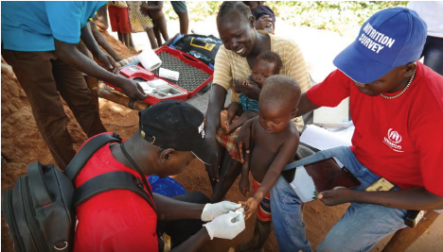
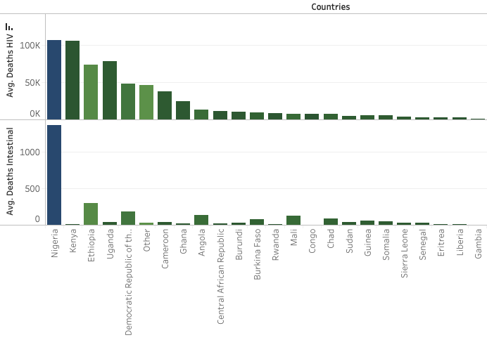
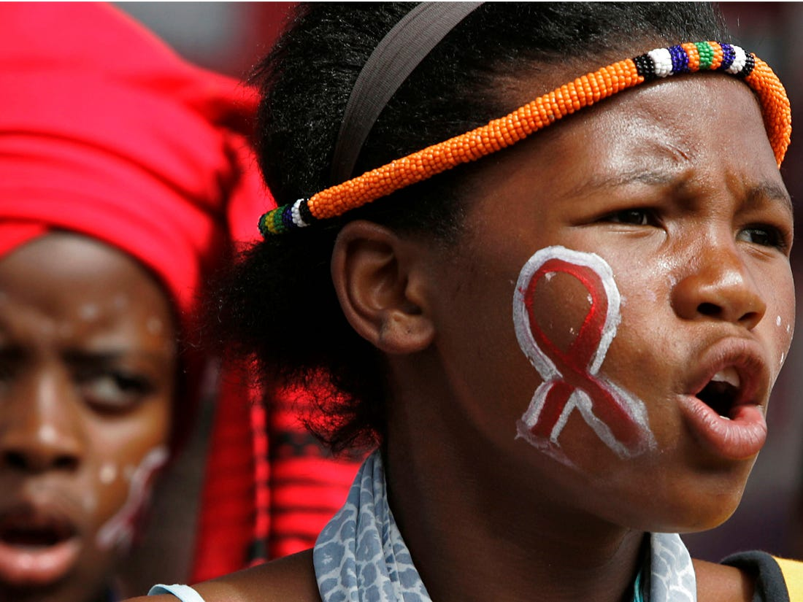
Comparing HIV AIDS and Intestinal Disease Deaths (with Total Deaths) per Country

Slide 10
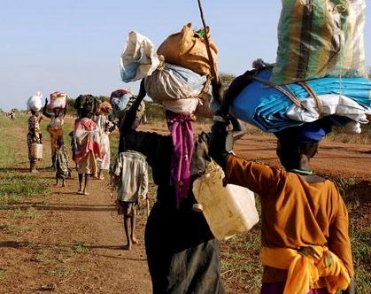
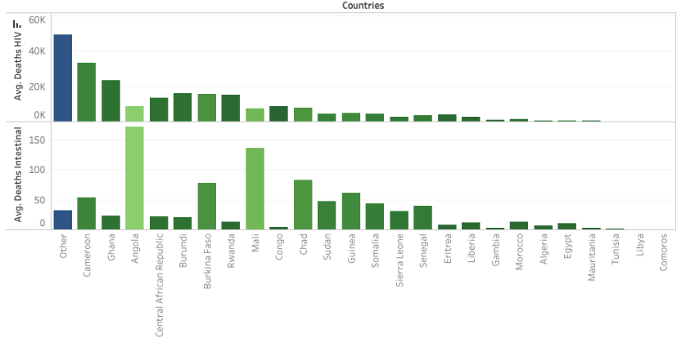
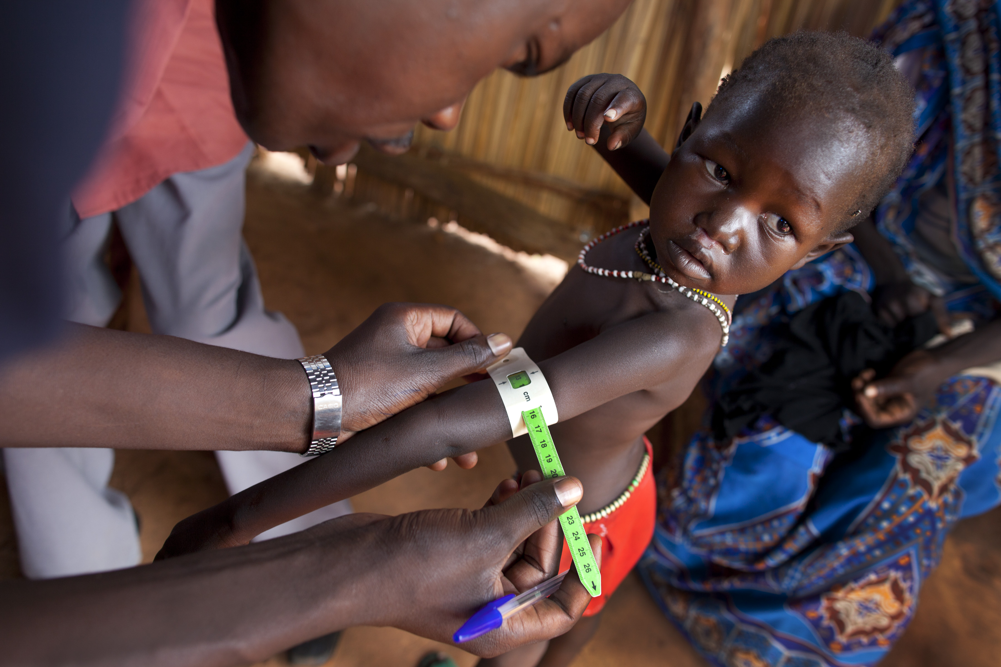
Comparing HIV AIDS and Intestinal Disease Deaths (with Total Deaths) per Country

Slide 11
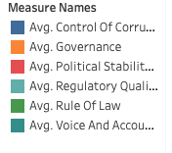
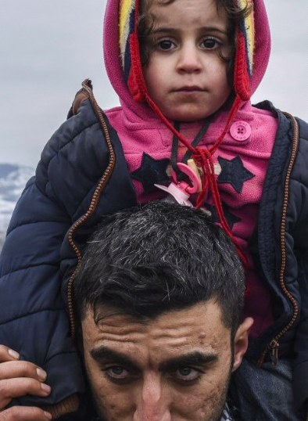
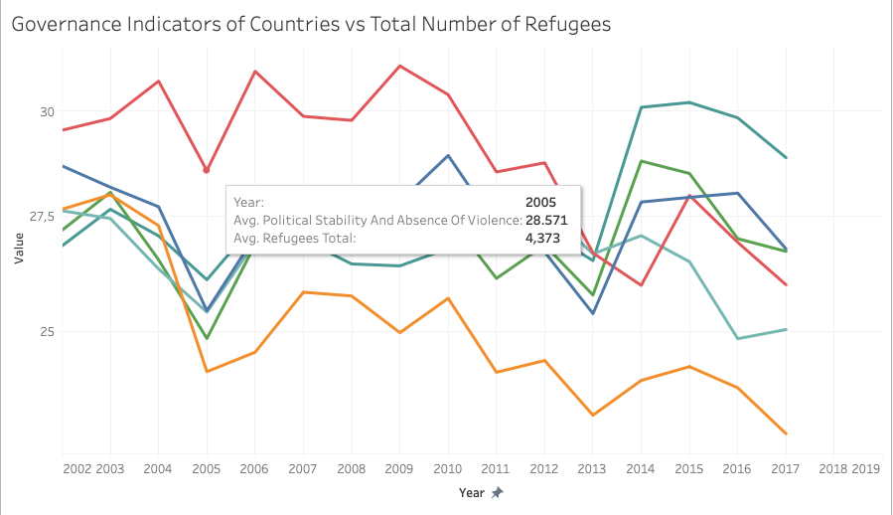
Governance Indicators of Countries vs Average Number of Refugees

Slide 12
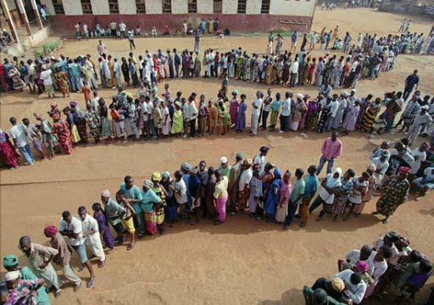
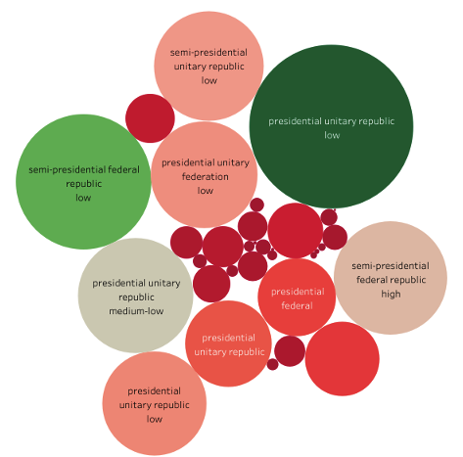
Comparison Between Forms of Governments and Number of Refugees

Slide 13
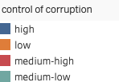
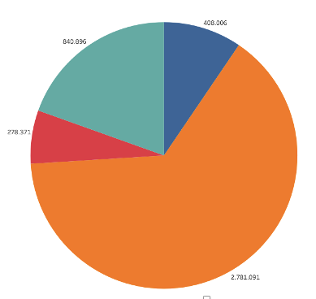
Breakdown of Number of Refugees by Control of Corruption

Slide 14

Recommendations
Necessities – Water and Sanitation
Increased coverage
Control of Disease and Healthcare
Reducing the deaths caused by diseases
Governance Indicators
Increased performance of governance
Holistic Approach
Causes
Preparedness
Investment and Partnership

